Slide 1
DPM Exam Overview
2021

Slide 2
Format of the DPM exam
Part 1 MCQ
75 question stems, each with 5 true/false completions in 2.5 h
Wednesday 15 September 2021
Certificate of Pharmaceutical Medicine is awarded on passing Part 1
Candidates must pass Part 1 before being eligible to sit Part 2
Part 2 written papers: SAQ and CAP
Short Answer Paper – 10 questions in 2.5h
Critical appraisal paper – read and answer questions on a published paper in 2.5h
SAQ Monday 11 October 2021, CAP Tuesday 12 October 2021
Candidates who pass one of the Part 2 papers but fail the other, only have to retake the paper they failed next time (with limitations, see FPM website)
DPM is awarded on passing Part 2
Pass rate of DPM Part 2 was 79% in 2020

Slide 3
MCQ Paper
Tests factual knowledge
Questions have a lead-in “stem” with five T/F completions
Sometimes all will be true; sometimes all will be false; mostly there will be a mix of true and false
75 questions x 5 responses = 375 marks
Time allowed: 2.5 hours
No negative marking
Each correct answer scores 1 mark
Incorrect or no answer scores 0 marks
Random answers score 50%

Slide 4
Top tips for the MCQ
You have to revise!
No negative marks so don’t leave blanks

Slide 5
SAQ Paper
10 questions
Tests factual knowledge / ability to interpret data
All questions to be answered
Candidates must gain marks on at least 8 questions
Time allowed: 2½ hours (15 mins/question)
Answer in bullets or short notes
Notes:
5

Slide 6
SAQ Top Tips
You have to revise – this is a knowledge paper
ANSWER THE QUESTION (you cannot get marks for answering a different question)
Allow time for attempting all questions…score zero in >3 = FAIL
Start with questions you can answer easily
Marking scheme guides number of points required (but some may be ½ marks --- the question may say how many answers we require – but don’t assume)
Use past questions as a guide to format (although questions are not re-used topics may be similar)

Slide 7
CAP
Tests ability to read and critique a scientific paper
Fundamental requirement whatever discipline of pharmaceutical medicine you work in
Typically 13-14 questions (around 40% factual, 60% critique)
No requirement for all questions to be answered – but lose marks if you don’t!
Time allowed: 2½ hours
Answer in bullet form or short notes
You DO NOT need specialist knowledge in the disease area of the article
Notes:
7

Slide 8
CAP
Be careful what is being asked for:
For a factual answer e.g., List or Briefly describe
vs.
Your critique / opinion e.g. Give reasons for, Explain or Comment on ……
Think …..“why is this important”….the “so what!”
This is a technique paper
… so practice, practice, practice

Slide 9
CAP Top Tips
Read the whole paper
Don’t just try to look through for the answers
Don’t worry about anything blacked out (redacted)
Read the question
Valid comments not addressing the question will not score any marks
Answers should be concise
Understand common terms: e.g., design, “in lay terms”, disposition
Note the number of marks available
The content of the answer should be roughly proportional to the marks available
For the “critique” questions
Don’t just give statements of fact without the “so what” or “why”
Comments can be about positive as well as negative aspects

Slide 10
Marking and standard setting
MCQ is marked electronically,
SAQ questions and CAP papers are marked by pairs of experienced examiners from BoE
A third marker will mark papers if there is a discrepancy between the two markers
The pass mark is set for each paper each year
There is no set proportion of candidates who can pass
The standard setting panel is comprised of 10-15 experienced examiners including one or more non-UK graduate or person whose first language is not English.
Questions vary in their degree of difficulty.
What questions or parts of questions should a just-passing candidate know the answer to?
Either the knowledge is at a foundation level or the topic is very important

Slide 11
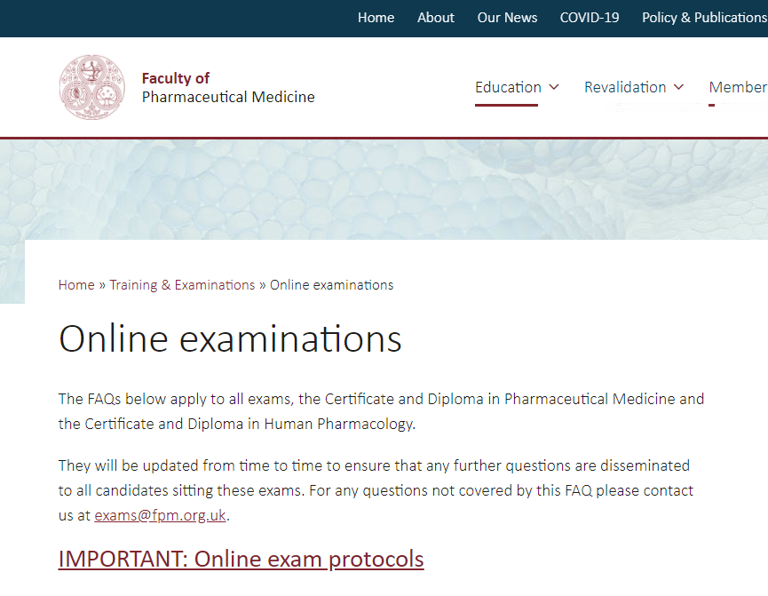
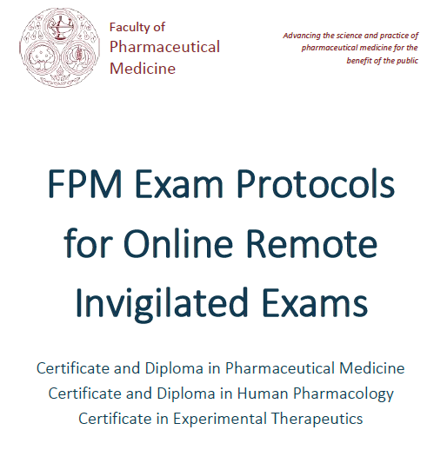
Electronic exams
In 2021, the exams can be taken on line from home/office
Provided by TestReach using remote invigilation
Details available on the FPM website.
The exam protocol can be reviewed at https://www.fpm.org.uk/wp-content/uploads/2020/08/FPM-online-exam-protocols-2020-1.pdf
Q&A can be found at https://www.fpm.org.uk/training-exams/covid-19-and-examinations/

Slide 12
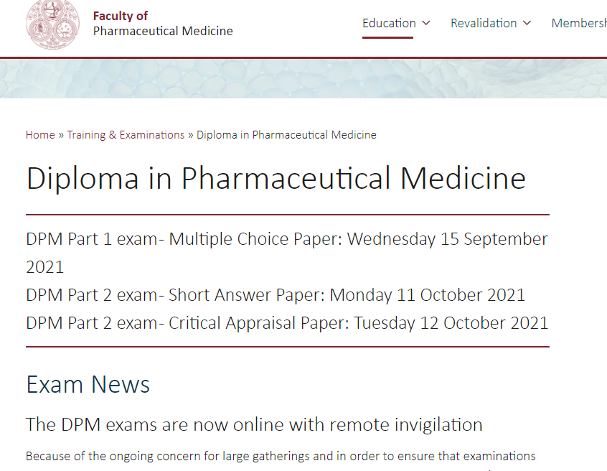
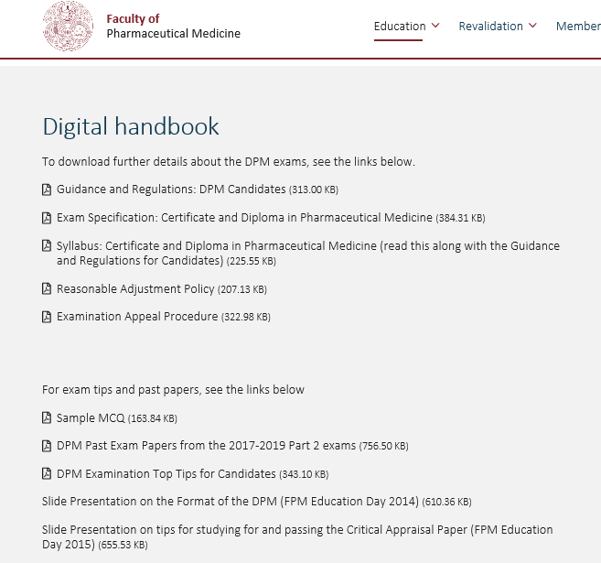
FPM Resources

Slide 13
Any questions?

