Slide 1
DPM Exam Overview
Ruth Dixon
April 2020

Slide 2
Contents
Overview of DPM
MCQ
SAQ with examples
CAP

Slide 3
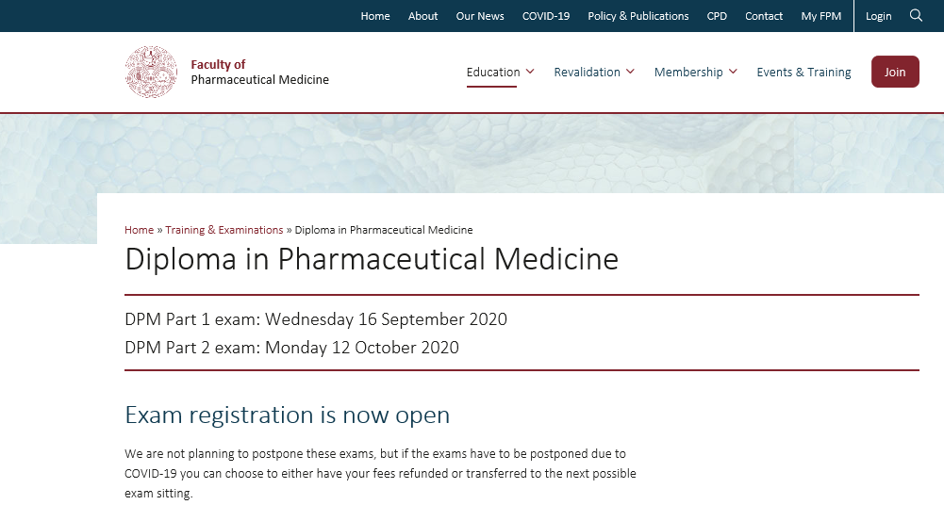
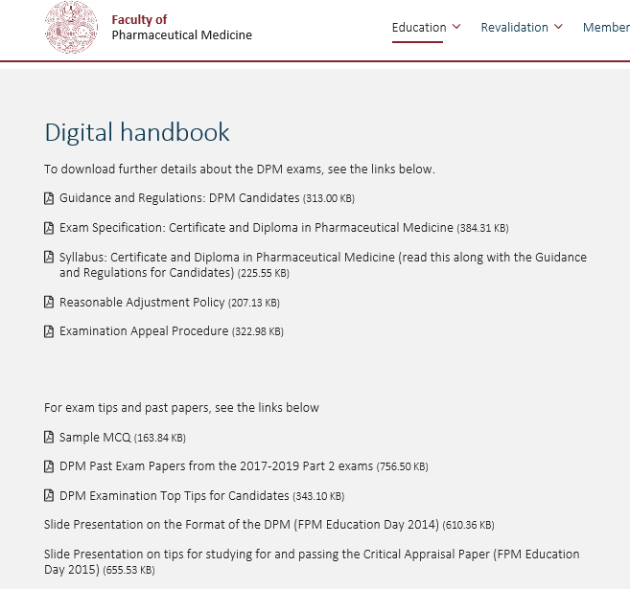
FPM Resources

Slide 4
Changes to the DPM
1979 First DPM
2005 Negative marking stopped in MCQ
2010 Viva exam changed to written CAP
2011 Essay paper discontinued
2013 Diploma split into Part 1 and Part 2
2019 DPM exam uses Pharmatrain 2018 syllabus
2019 CPM awarded for Pass in Part 1 MCQ
2019 Pass one of the papers in Part 2, don’t have to retake it for 3 years
2021 Electronic exams

Slide 5
Current format of the DPM exam
Part 1 MCQ
  75 question stems, each with 5 true/false completions in 2.5 h
  Held annually in mid September
CPM is awarded on passing Part 1
Candidates must pass Part 1 before being eligible to sit Part 2
Candidates may sit both parts same year
Part 2 SAQ and CAP
  SAQ – 10 questions in 2.5h
  Critical appraisal paper (CAP) – read and answer questions on a published paper in 2.5h
  Held annually in mid October
DPM is awarded on passing Part 2

Slide 6
Part 1 and Part 2
We recommend applying for both Parts 1 & 2 in the same year
If you fail Part 1, you get a refund of Part 2
If you pass Part 1, but defer Part 2, get a refund minus admin fee
You cannot take Part 2, if you pass Part 1, in same year unless you’ve applied
From 2019, if you pass one of the Part 2 papers but fail the other, you only have to retake the paper you failed next time
You have to attempt both the SAQ and the CAP together the first time;
A pass in one of the Part 2 papers is time-limited, in order to maintain the expected standard for current knowledge across the curriculum:
  Candidates have 3 opportunities to pass the previously failed paper (generally 3 years) before having to re-sit the paper they already passed.
  Example: If a candidate takes the Part 2 in 2019, and passes the SAQ but fails the CAP, they then have the yearly sitting in 2020, 2021 and 2022 to pass the CAP separately. If they don’t pass the CAP in 2022, they then have to start again with the Part 2 and take both the SAQ and CAP together.
  The FPM can allow an extension if there are extenuating circumstances

Slide 7
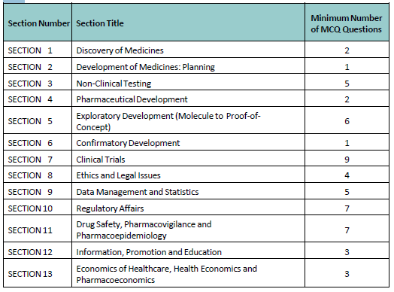
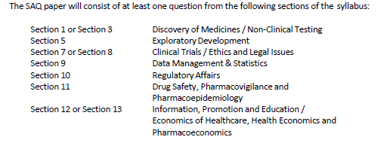
Exam Specification (from 2018 onward)
MCQ Paper
Required by GMC
Provides a more defined structure for the content of the exam
Also provides for structured feedback to unsuccessful candidates
SAQ Paper

Slide 8

2019 examination
Pass rate for MCQ 79.5%
Pass rate for Part 2: 43 took Part 2 & 32 passed (74.4%)
  3 distinctions
  4 failed both CAP and SAQ
  4 failed the SAQ only
  3 failed the CAP only

Slide 9
Multiple Choice Question (MCQ) Paper

Slide 10

MCQ Paper
75 questions x 5 responses = 375 marks!
Time allowed: 2.5 hours
No negative marking
  Each correct answer scores 1 mark
  Incorrect or no answer scores 0 marks
Random answers score 50%

Slide 11
Multiple Choice Questions
Test factual knowledge
Have a lead-in “stem” with 5 completions
  Any number of the completions will be true
  Sometimes all will be true; sometimes all will be false; mostly there will be a mix of true and false
Questions must be:
  Within the syllabus
  Worth asking – does it matter?
  Clear and unambiguous
  In plain English
Avoid tricks, such as an accurate statement but the incorrect source e.g.,
    According to ICH GCP, appropriate caution must be exercised in the conduct of medical research that may harm the environment

Slide 12
Pass mark / marking
Marking by computer
Pass mark is set by a bookmarking technique by a standard setting panel from the BoE
The panel reviews each question to see how well it has been answered and any outliers.
Pass mark typically ≈ 72-73%

Slide 13

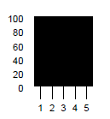
Examples from the MCQ Paper
According to ICH Good Clinical Practice, a clinical trial protocol must be signed by:
    ………………….completion…. T/F?
Question easy – all got it correct, no discrimination

Slide 14
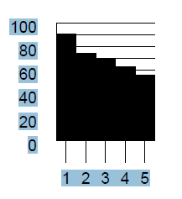
Examples from the MCQ Paper
The following factors can affect the pharmacokinetic
properties of a compound administered orally:
    …………………. completion…. T/F………….
The top 20% answered the
question better than the
bottom 20%
i.e. good discrimination

Slide 15
Examples from the MCQ Paper
With respect to bioequivalence studies:
        …………………. completion…. T/F…
The bottom 20% answered the question better than the
top 20%
i.e. less discriminating but not
necessarily a problem
But in general prompts us to double check – was the question correct or ambiguous

Slide 16

Top tips for the MCQ
You have to revise!
No negative marks so don’t leave blanks

Slide 17
Short Answer Question (SAQ) Paper

Slide 18
SAQ Paper
10 questions
Tests factual knowledge / ability to interpret data
All questions to be answered
  Candidates must gain marks on at least 8 questions
  Time allowed 2½ hours (15 mins/question)
Answer in bullet form style
Notes:
18

Slide 19
Pass mark / marking
Pass mark for each question set by a panel of experienced examiners before the exam
Pass mark typically around 55%
A pair of examiners independently mark all scripts for one question
Average score taken
If >2 marks difference between the examiners, a third marker (blinded to other scores) marks. Median score then taken.

Slide 20
Examples from the 2019 SAQ paper
1 | You are the pharmaceutical physician responsible for reviewing the non-clinical data package to decide if a candidate drug should be taken into first in human studies. The data from the repeat dose in vivo dog study show a significant reduction in renal function. Briefly describe 10 important factors/considerations that will help to decide whether to take this candidate drug into first in human studies. |  | (10 marks)

Slide 21
Examples from the 2019 SAQ paper
1 | You are the pharmaceutical physician responsible for reviewing the non-clinical data package to decide if a candidate drug should be taken into first in human studies. The data from the repeat dose in vivo dog study show a significant reduction in renal function. Briefly describe 10 important factors/considerations that will help to decide whether to take this candidate drug into first in human studies. |  | (10 marks)
Read the question
You need to write at least 10 points but you can write more
Briefly describe – write a few lines for each point, more than just a list.

Slide 22
A good answer might include……
What dose/exposure did the significant reduction in renal function occur
NOAEL and margin to NOAEL
Exposure relationship
Extent of renal impairment
Time to onset
Reversible?
Histology in the dogs, any renal damage?
Class effect?
Other species affected
Other toxicology findings
Mechanism of action for reduced renal function
Predicted IC50/efficacy in man and therapeutic window
Planned indication in the clinic (risk benefit)
Comorbidities in target population ?higher risk
Likely con meds could increase risk in target population
Duration of dosing intended for efficacy in man – single dose vs life-long treatment
Is the reduction in RF monitorable?

Slide 23
A poor answer…..
Describes a standard non-clinical toxicology package prior to FTIH
Suggests carcinogenicity studies
Doesn’t mention the renal findings
Doesn’t address the question

Slide 24
Examples from the 2019 SAQ paper
7 | What is the meaning of “expected” with reference to an adverse drug reaction (ADR) with an investigational medicinal product? What reference would you use to judge whether an ADR is expected: in a clinical trial with an unlicensed medicine? for a spontaneous report with a marketed product? What is the time-frame for expedited reporting by the Sponsor to regulatory authorities of a: fatal or life-threatening unexpected ADR? serious, unexpected ADR that is not fatal or life-threatening? What is the purpose of the company core datasheet (CCDS)? List the sections of the CCDS that comprise the core safety information. |  | (2 marks) (1 mark) (1 mark) (1 mark) (1 mark) (2 marks) (2 marks)
The extent of your answer should be guided by the number of marks available for each part. Don’t write a page for one mark!
“List” means just one or a few words for each.
Don’t assume one mark for each bullet! Give them all.

Slide 25
Examples from the SAQ paper
2 | For a healthy volunteer, single ascending dose, first in human study, dose escalation meetings are held. Briefly describe the data required to be reviewed during these meetings. Briefly describe 4 potential outcomes following review of data at these meetings. Briefly describe 3 important logistical considerations for the conduct of each meeting |  | (3 marks) (4 marks) (3 marks)

Slide 26
Examples from the SAQ paper
2 | For a healthy volunteer, single ascending dose, first in human study, dose escalation meetings are held. Briefly describe the data required to be reviewed during these meetings. Briefly describe 4 potential outcomes following review of data at these meetings. Briefly describe 3 important logistical considerations for the conduct of each meeting |  | (3 marks) (4 marks) (3 marks)
Read the question
Briefly describe – write a few lines for each (more than a list.)

Slide 27
A good answer might look like……
Data required to be reviewed
Safety data
  Any data listed in the protocol as stopping criteria or required to be reviewed, e.g., specified DLT, SAEs, AEs, safety labs, vital signs, ECGs etc.
PK data: Cmax, AUC, etc. in case of any Cmax/exposure stopping rule
PD data, if relevant biomarker, e.g. scales, questionnaires, pharmacoEEG, etc.
PK/PD relationship
c) logistical considerations: data availability, participants, documentation, timing etc etc
b) 4 potential outcomes
Escalate as planned per protocol (No concern)
Stop further dosing (Study stopping criteria met)
Repeat dose level (Signal of unknown significance or issues with conduct of cohort / insufficient subjects/data)
Dose at an interim level (Signal of potential concern but monitorable)
Protocol amendment to e.g., givea dose greater than that defined per protocol
Urgent safety measures/amendments

Slide 28
A not so good answer might…..
Simply say “safety data” without further description
Talk about the non-clinical FTIH package
Talk about something else instead of logistics

Slide 29
SAQ Top Tips
You have to revise – this is a knowledge paper
ANSWER THE QUESTION
(you cannot get marks for answering a different question)
Use a bullet point format and write legibly please
Allow time for attempting all questions…score zero in >3 = FAIL
Start with questions you can answer easily
Marking scheme guides number of points required
(but some may be ½ marks --- we are increasingly saying how many answers we require – but don’t assume)
Use past questions to guide revision
(although questions are not re-used – topics may be similar)

Slide 30
Critical Appraisal Paper (CAP)

Slide 31
CAP Introduction
Tests ability to read and critique a scientific paper
Fundamental requirement whatever discipline of pharmaceutical medicine you work in
Typically 13-14 questions (around 40% factual, 60% critique)
No requirement for all questions to be answered – but lose marks if you don’t!
  time allowed 2½ hours
  question paper and article given at same time
Answer in bullet form style please! (no essays)
You DO NOT need specialist knowledge in the disease area of the article
Notes:
31

Slide 32
Pass mark / marking
Pass mark for each question set by a panel of experienced examiners before the exam
Pass mark typically around 31 out of 50
A pair of examiners independently mark all scripts for one question
Average score taken
If discrepancy between the examiners, the two markers discuss or a third marker (blinded to other scores) can mark.

Slide 33
CAP
Be careful what is being asked for:
For a factual answer
e.g., List or Briefly describe
vs.
Your critique / opinion
e.g. Give reasons for, Explain or Comment on ……
Think …..“why is this important”….the “so what!”

Slide 34
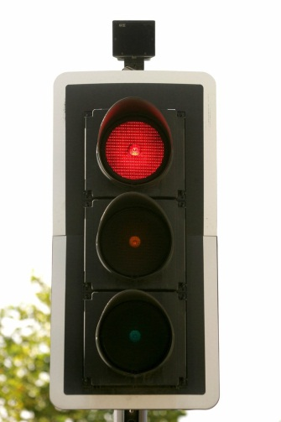
Example:
Exclusion criterion
= presence of a red traffic light
Question:
“Comment on the rationale for the exclusion criteria (do not simply repeat the inclusion / exclusion criteria)”

Slide 35

Example:
Not answered Q
So what?
Poor answer = Red traffic light
Partial answer = Red traffic light so can’t cross the road
Good answer = Red traffic light, so can’t cross the road because it may be unsafe as high risk of getting run over!
What about an exclusion criterion of GFR <30ml/min?

Slide 36

CAP example: description and comment
a) Describe in detail how sacroiliitis was determined. (2 marks)
b) Comment on the limitations of the radiological investigation in this study (3 marks)

Slide 37
CAP Top Tips
Read the whole paper
  don’t just try to look through for the answers
  don’t worry about anything blacked out (redacted)
Read the question
  valid comments not addressing the question will not score any marks
Answers should be concise and legible
Understand common terms: e.g., design, “in lay terms”, disposition
Note the number of marks available
  the content of the answer should be roughly proportional to the marks available
For the “critique” questions
  don’t just give statements of fact without the “so what” or “why”
  comments can be about positive as well as negative aspects

Slide 38


CAP summary
This is a technique paper
  … so practice, practice, practice
There is no quota to pass / fail
  …it is up to you

Slide 39
Role of BoE
and don’t forget

Slide 40
Overall Adjudication – Part 2
Any candidate who fails SAQ/CAP reviewed
Could a small change in a paper affect the overall result?
If yes, the marking is reviewed
BoE meeting discuss any borderline case / ratify results

Slide 41
Don’t forget
Work together .... You are not competing with each other (study groups)
Look at past papers
Don’t run out of time
Look at the FPM website (past papers, BoE newsletters etc...)

Slide 42

Good luck to those taking the DPM
Once you have your CCT, we will write to you to join the Board of Examiners
Please give something back!

